Slide 1
Developing dynamic web pages using Servlets
COURSE OVERVIEW

Slide 2
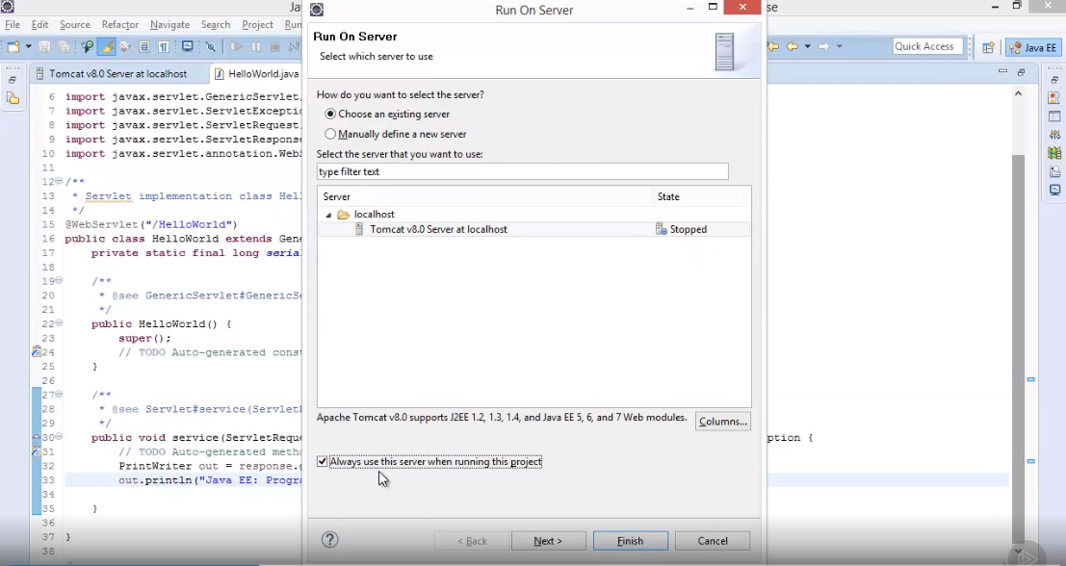

Slide 5
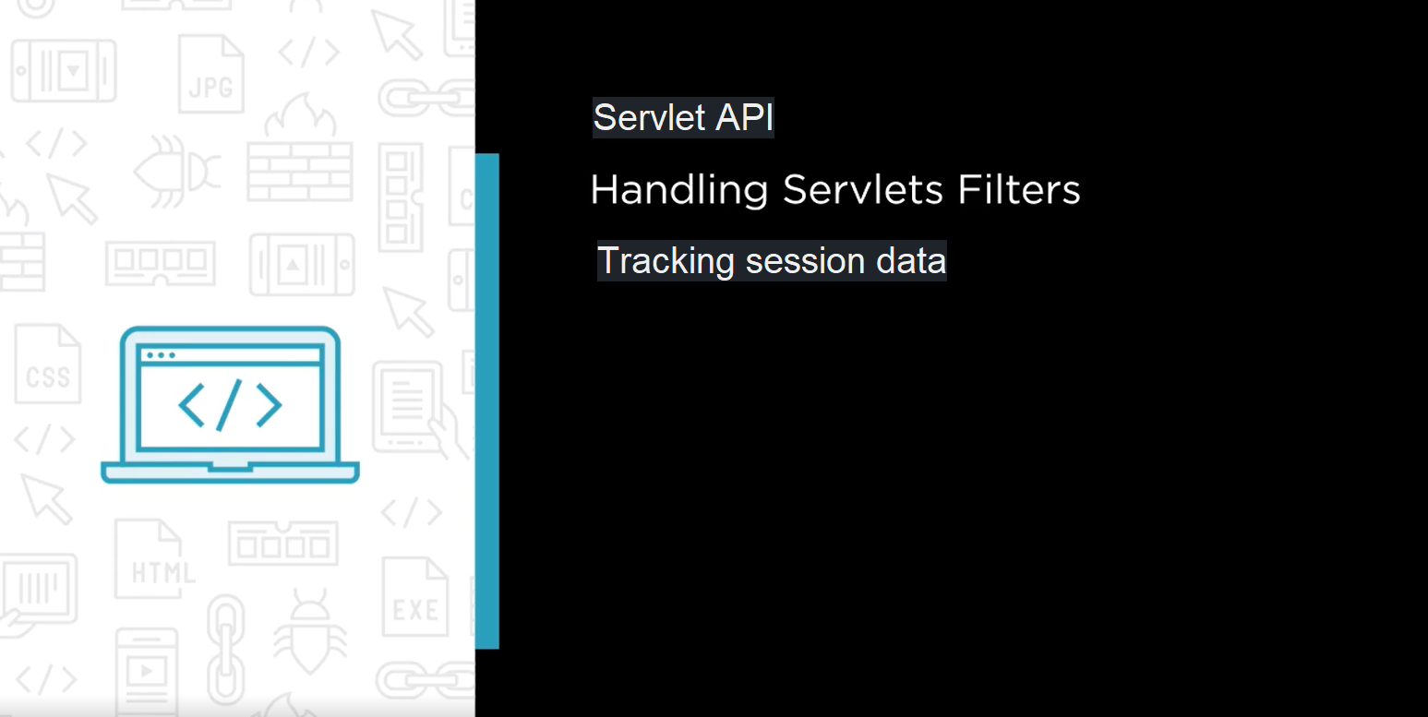
Request Dispatcher
Web annotations
HTTP Requests and Responses

Slide 6
